Slide 1
HARISH S
B.Tech AI & DS
SINCET
NAAN MUDHALVAN PROJECT

Slide 2
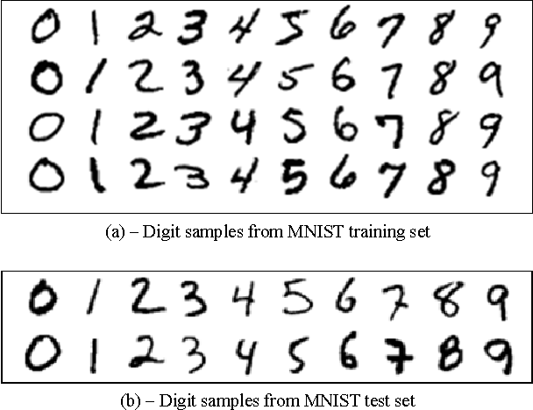
HANDWRITTEN DIGIT FOR RECOGNITION

Slide 3


AGENDA
1. Define the project scope and objectives
2. Data collection and preprocessing
3. Data splitting
4. Model selection:
5. Model training:
6. Model evaluation
7. Model testing
8. Model deployment
9. Performance monitoring and optimization
10. Documentation and reporting
3/21/2024 Annual Review

Slide 4

PROBLEM STATEMENT
The handwritten digit recognition problem statement involves the task of developing a machine learning model that can accurately identify and classify handwritten numerical characters (0-9) from images.
This task is challenging due to variations in writing styles, different penmanship, noise in the input data, and the need for the model to generalize well to unseen data.
The goal is to create a system that can effectively differentiate between different digits and accurately recognize handwritten characters in various contexts.

Slide 5
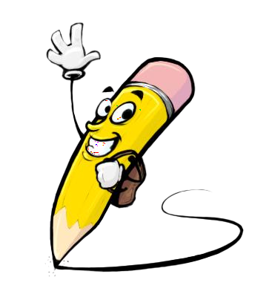
PROJECT OVERVIEW
The handwritten digit recognition problem involves the task of developing a machine learning model that can accurately identify and classify handwritten numerical characters (0-9) from images.
This task is challenging due to variations in writing styles, different penmanship, noise in the input data, and the need for the model to generalize well to unseen data.
The goal is to create a system that can effectively differentiate between different digits and accurately recognize handwritten characters in various contexts.

Slide 6

WHO ARE THE END USERS?
The end users of handwritten digit recognition systems can include researchers, developers, businesses, educational institutions, and individuals.
Researchers and developers may use these systems for experimentation and algorithm development. Businesses may utilize digit recognition for document processing, form recognition, data entry, and other operational tasks.
Educational institutions may use digit recognition for grading assignments, analyzing student performance, and creating interactive learning tools.

Slide 7
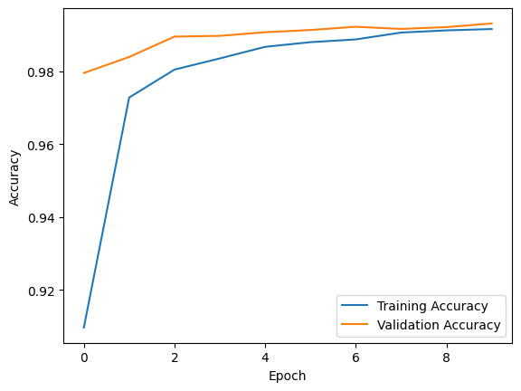
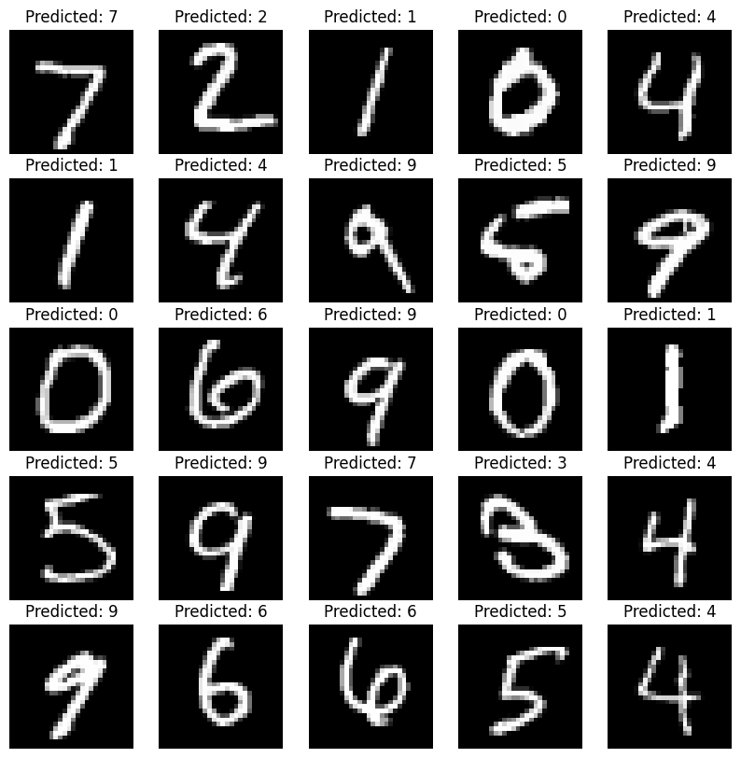
SOLUTION AND ITS VALUE PROPOSITION
Training accuracy & validation accuracy
contoured solution

Slide 8

THE WOW IN YOUR SOLUTION
WowWrite: Revolutionizing Handwritten Digit Recognition.
Ink Imprint: Wow-Worthy Handwritten Digit Recognition.
Digits Inscribe: A Wow-Inducing Handwritten Recognition Project.
ScriptSavant: Wow-Powered Handwritten Digit Recognition.
GraphoGenius: Wow-Factor Handwritten Digit Recognition.
3/21/2024 Annual Review
‹#›

Slide 9
MODELLING
Our proposed model architecture consists of multiple layers of convolutional and recurrent neural networks.
The initial layers of the CNN extract meaningful features from the input images, capturing spatial hierarchies and patterns.
These features are then passed onto the RNN layers, which leverage sequential information to further refine the representation of the digits.
The final layers include fully connected neural networks for classification, where the model predicts the digit corresponding to the input image.
‹#›

Slide 10
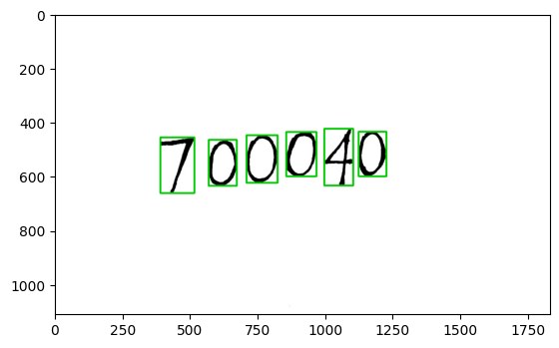
RESULTS
‹#›

